Slide 1



ABRAMORAMA
Campaign Performance Report

Slide 2
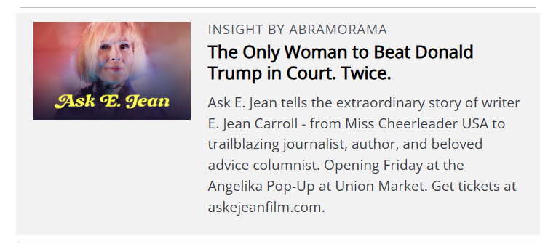
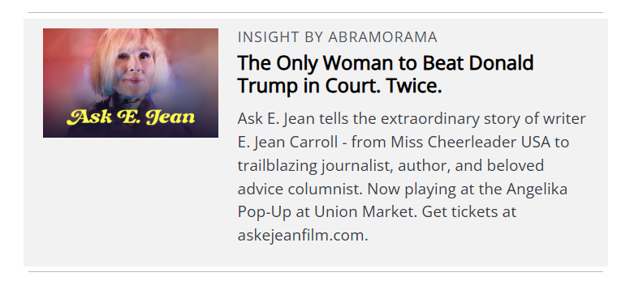

DMV Daily Promotion
86,728
Sends
55,502
Opens
51
Clicks
Date​ | ​ Sends​ | ​ Opens​ | ​ Clicks
22-Jul | 43,422 | 26,754 | 14
24-Jul | 43,306 | 28,748 | 37

